Slide 1
BDA Project Presentation
Logistic regression on Breast Cancer data
Jonne Kurokallio
Ales Suchomel

Slide 2
Introduction
Bayesian workflow and analysis to breast cancer dataset
Binary classification task
Multiple logistic regression models
Models differ by the used priors and chosen features
Models compared using leave-one-out cross-validation
Predictive performance was evaluated on the best model

Slide 3
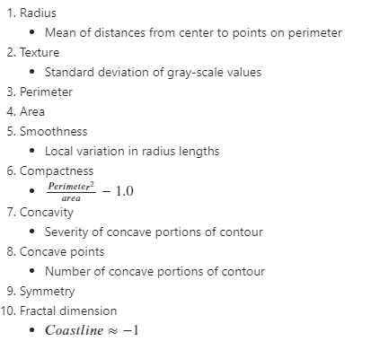
Wisconsin breast cancer data set
Total of 10 numerical features with binary labels (M, B)
569 measurements of fine needle aspiration extractions

Slide 4
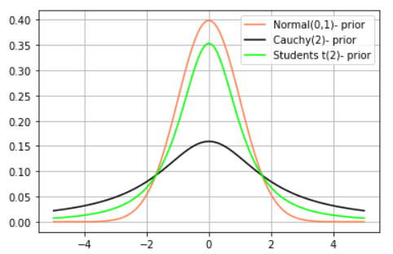
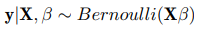
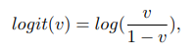
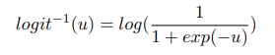
Models
Priors
All weakly informative
Three different prior choices
Base model
Linear correlation between features and predictions
Bayesian formula
Likelihood
Link function and its inverse

Slide 5
Data processing pipeline
Data preprocessing (standardization, PCA, feature selection)
set of 6 different datasets (Origin, Standardized, Custom-5, PCA-all, PCA-6, PCA-3)
Data splitting (setting apart 20 percent of points for final evaluation)
train and test sets of the prepared datasets
Stan model compilation (classifiers differentiated by priors, flexible regarding feature counts)
set of 3 interchangeable StanModel objects (Normal, Student-T, Cauchy)
Default sampling (all combinations of models with train datasets)
many warnings (divergences, Rhat > 1.1, k_patero > 0.7, tree depth saturation)
Tuning stan options (finally setting max_treedepth = 15, iter_count = 2200, rest to default)
only few warnings regarding k_patero > 0.7, No Rhat warnings
Generating posterior draws (all combinations of models with both test and train datasets)
set of 18 StanFit4Model objects with point-wise log-likelihoods and posterior draws for both splits

Slide 6
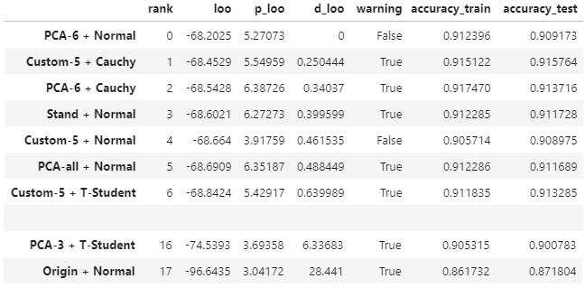
Comparison and sensitivity
No significant differences in scores (elpd, accuracy) for most dataset-prior combinations.
The classification is robust to changes in priors, dimensions and preprocessing.
Other findings:
both train and test accuracies were consistently around 0.91
most of elpd values (loo) differed only insignificantly
standardization was necessary
5 features was enough
warnings were not fully eliminated
Fig 1: Table comparing scores reached by sampling all combinations of priors and datasets.

Slide 7
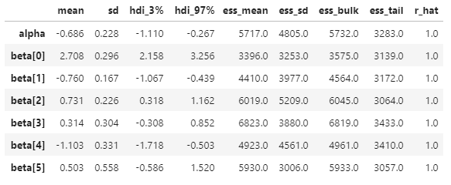
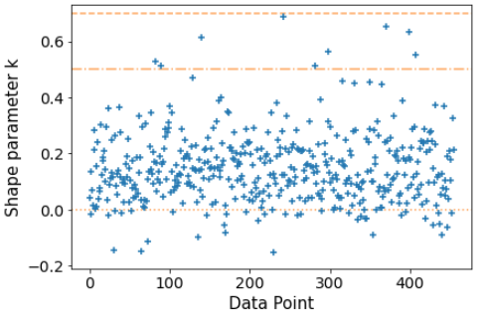
Detailed characteristics
of logit classifier with normal prior trained on first 6 PCs (PCA-6 + Normal).
Often cause a warning
Fig 2: Table summarizing the resulting statistics and diagnostics of the normal-prior model parameters trained on the PCA-6 dataset.
Fig 3: Scatter plot of k-patero diagnostics of the normal-prior model trained on the PCA-6 dataset.

Slide 8
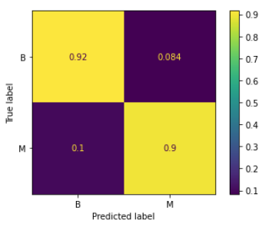
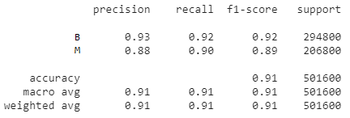
Predictive performance
of logit classifier with normal prior trained on first 6 PCs (PCA-6 + Normal).
Fig4: Classification scores of Normal prior model for test split of PCA-6 dataset.
10 % of malignant tumors uncaught is a problem...
Fig 5: Confusion matrix of Normal prior model for test split of PCA-6 dataset. Horizontally normalized.

Slide 9
Conclusions and improvements
Data easy to train for logistic classifier model
All models fit well and values converge
Prediction results are decent, but leave a lot to improve
Change in perspective: from binary classification to probability of tumour being malignant
Different types of priors
Better feature elimination for complete data set (32- features)

Slide 10
Summary
last slide / take home message. Do we need this?
Contact information:
Ales Suchomel – …
Jonne Kurokallio – jonne.kurokallio@aalto.fi

Slide 11
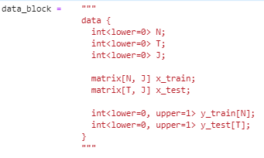
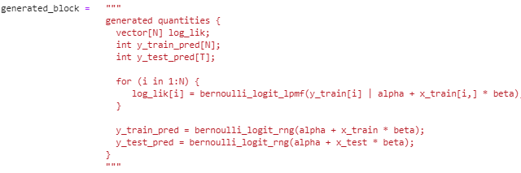
Appendices
Stan code:

Slide 12
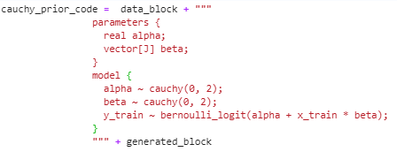
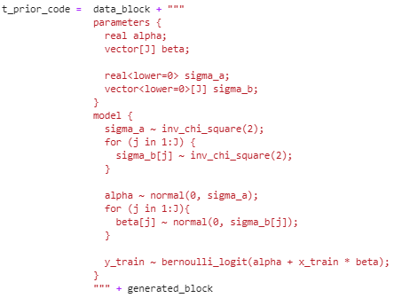
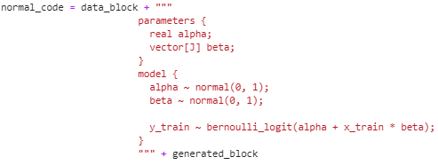

Slide 13
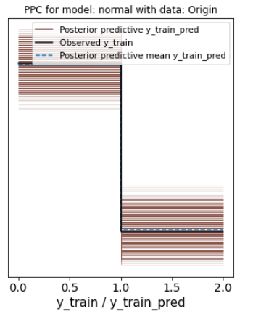
Posterior predictive checks

Slide 14
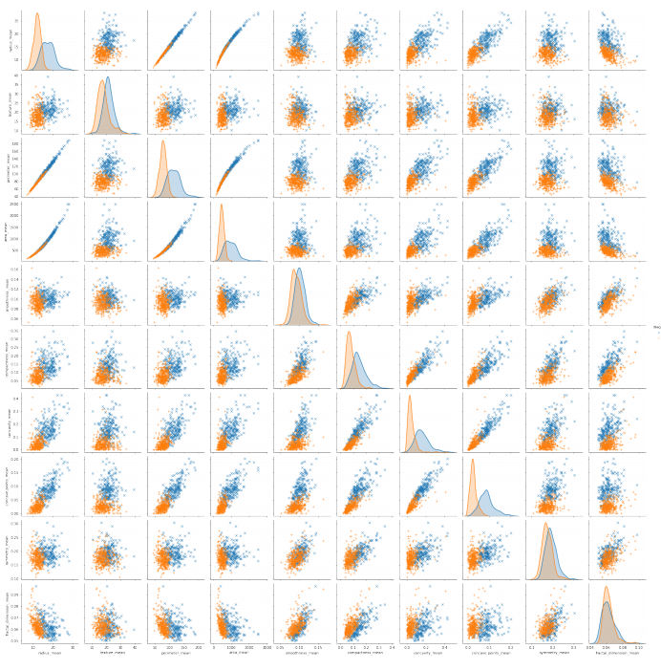
Data pairplot
Relative distributions of each feature

